Slide 1


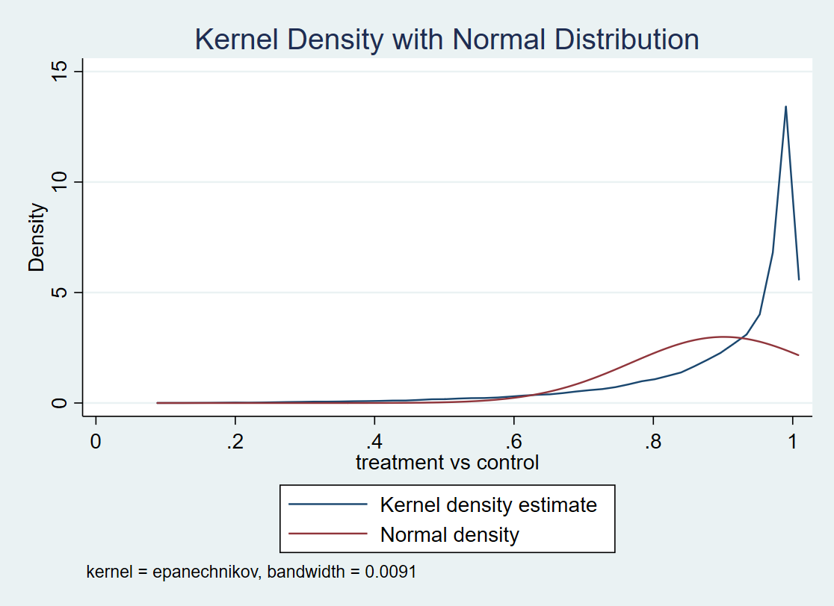
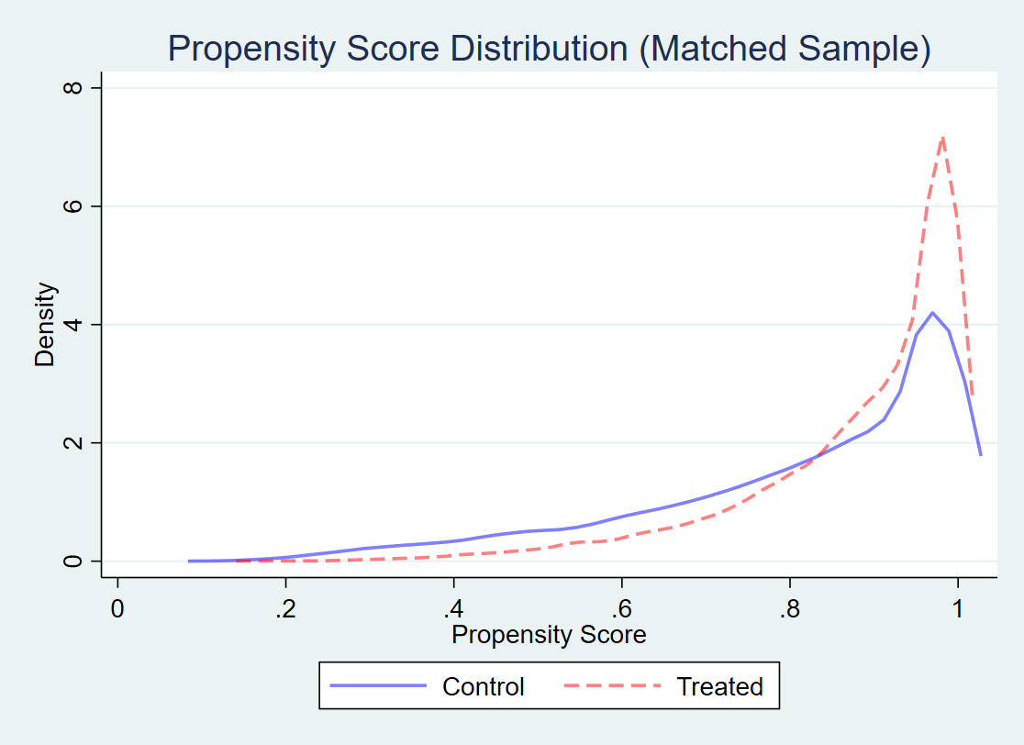
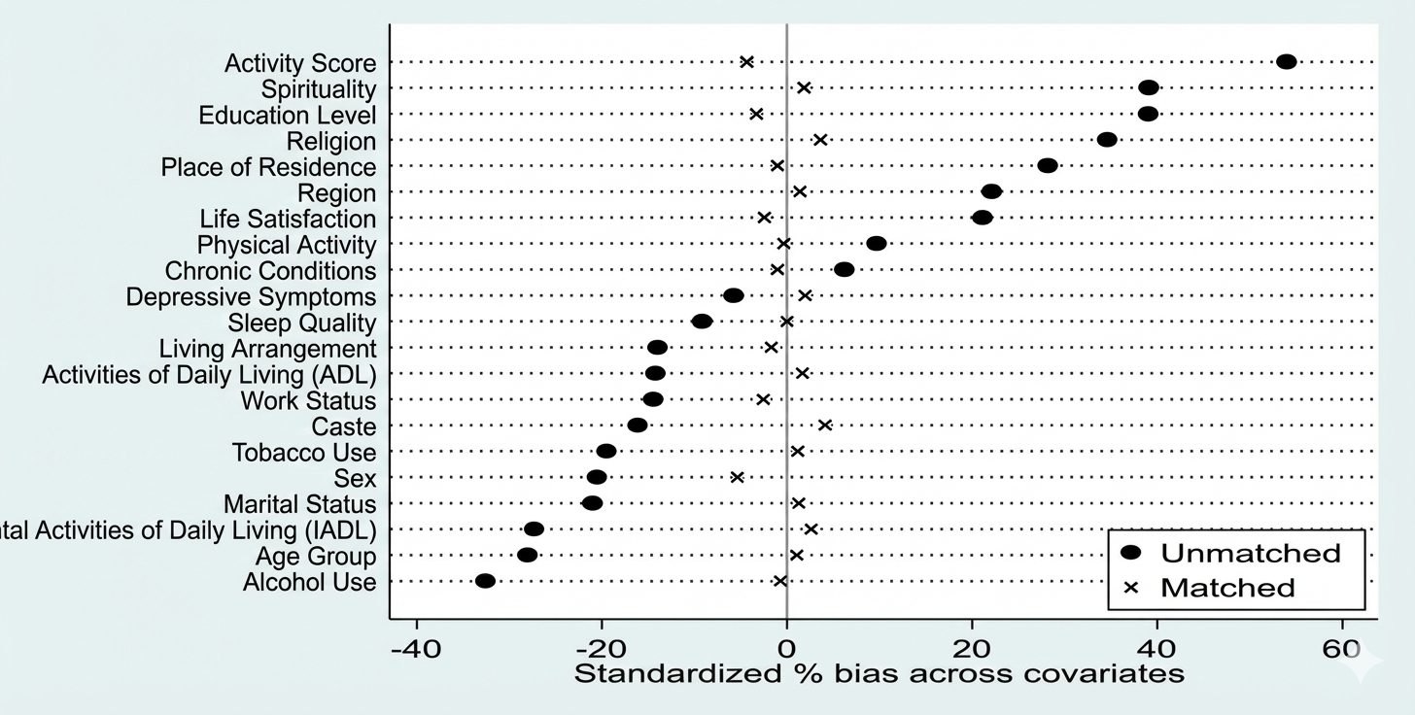
2nd International Conference on Longevity and Aging (Virtual)
Dec 20th - 22nd, 2025
Religious Engagement and Cognitive Function Among Older Adults in India: Evidence from LASI Wave 1
Ramnaresh, Shubham Tiwari, Tribeni Sonowal, Abhishek Anand
International Institute for Population Sciences
INTRODUCTION
RESULTS
Approximately 80% of research on Religion & Spirituality (R/S) and health involves studies on mental health. R/S involvement consists of psychological, social, and behavioral aspects that are more “proximally” related to mental health than to physical health (Koenig, 2012).
The overall prevalence of cognitive impairment among the older population is found to be substantially high with 13.7 % (Muhammad & Meher (2021).
Social engagements of older adults specially to the family-based care and support, beneficial effects of religiosity and religious involvement helps on mental health and cognitive function in older age.
Studies have revealed that spiritual and religious beliefs results in better cognitive outcomes.
1.
BALANCE PLOT
OBJECTIVES
Balance Plot (Propensity Score Distribution): Kernel density of propensity scores by treatment before and after matching; shows common support and overlap post-matching.
Estimate the association and causation between religious engagement and cognitive function among older adults in India.
2.
LOVE PLOT (STANDARDIZED % BIAS ACROSS COVIRIATES)
DATA SOURCE
DATA: Cross-sectional data from the first wave of the Longitudinal Ageing Study in India (LASI, 2017–2018).
SAMPLE: Nationally representative survey of older adults aged 45 and above (N = 68,407). 4,990 missing observations were deleted.
METHODOLOGY
Outcome: Cognitive functioning (binary/score mapped to analytic outcome in logistic/PSM analyses).
Exposure: Religious engagement (binary-religious vs non-religious, as coded in LASI for this analysis).
Covariates: age, sex, education, caste, region, residence (rural/urban), marital status, wealth index, physical activity, alcohol and tobacco use, ADL/IADL etc
STATISTICAL ANALYSIS
Chi-square tests were used to examine bivariate associations between religious engagement and cognitive functioning.
Unadjusted logistic regression estimated crude odds ratios, Adjusted logistic regression controlled for socio-demographic variables.
PSM applied to control confounding, with balance diagnostics and robustness checks confirming result stability using causal estimators.
Love Plot (Standardized % Bias Across Covariates): Shows large biases before matching (>40% for several covariates) and marked reduction to near zero after matching. (Include the actual plot produced via pstest, graph.)
3.
COMMON SUPPORT SUMMARY FROM PROPENSITY SCORE MATCHING
Treatment Assignment | Off Support | On Support | Total
Untreated | 2 | 10,882 | 10,884
Treated | 12 | 57,511 | 57,523
Total | 14 | 68,393 | 68,407
Only 14 cases fall outside common support, with 68,393 (>99.9%) retained, indicating excellent overlap and reliable PSM matching quality.
RESULTS
4.
TREATMENT EFFECT ESTIMATES ACROSS CAUSAL MODELS
Descriptive analysis indicates that 82% of older adults reported religious engagement, while the prevalence of poor cognition was 11% in the study sample.
PSM using a logit model (1:1 NN, caliper 0.1, common support) reduced mean bias from 22.7% to 2.1% ,showing excellent balance.
More than 90% bias reduction was achieved for most covariates; variance ratios were acceptable.
Before matching, the raw outcome difference was 12.3 Percentage(pp) (0.9149 vs 0.7919). After adjustment, the ATE was 3.95 pp and the ATU was 6.54 pp, indicating an overall ~4 pp higher cognitive score associated with religious engagement.
Effect Parameter | Treated | Controls | Difference | P-value
PSM: ATT (Avg. Treatment Effect on the Treated) | .914920624 | .880335936 | .034584688 | <0.001
PSM: ATU (Average Treatment Effect on the Untreated) | .914920624 | .880335936 | .065429149 | <0.001
PSM: ATE (Avg. Treatment Effect on the Treated) |  |  | 0.39492346 | <0.001
PSM results show that religious engagement is associated with a significant improvement in cognition. About 3.5 pp among the religious and nearly 4 pp on average, with even larger potential gains among the non-religious.
CONTACT:9828416506 |nareshkuri40@gmail.com

